Slide 1


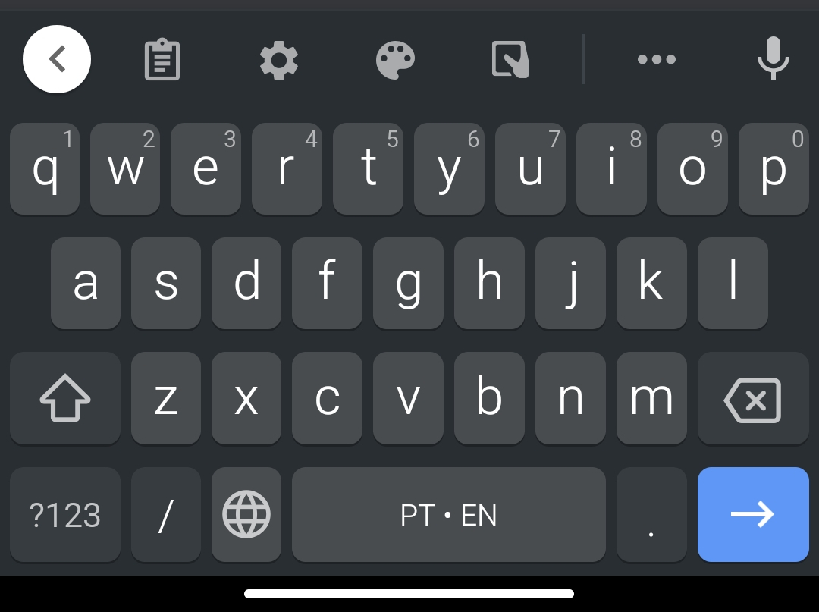
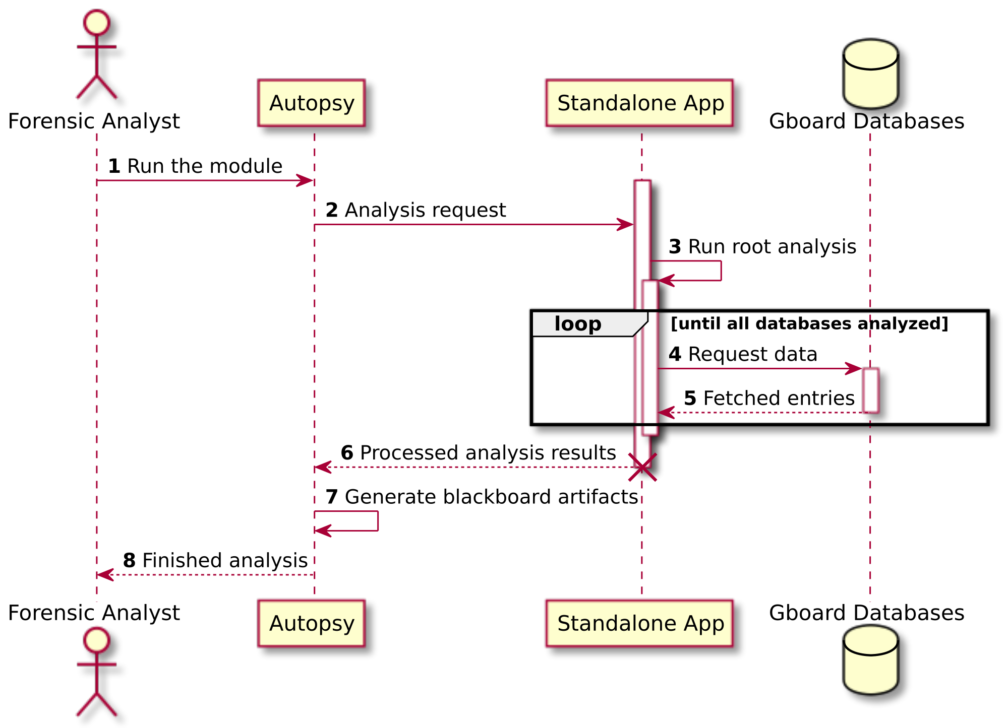
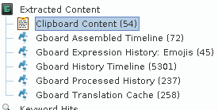
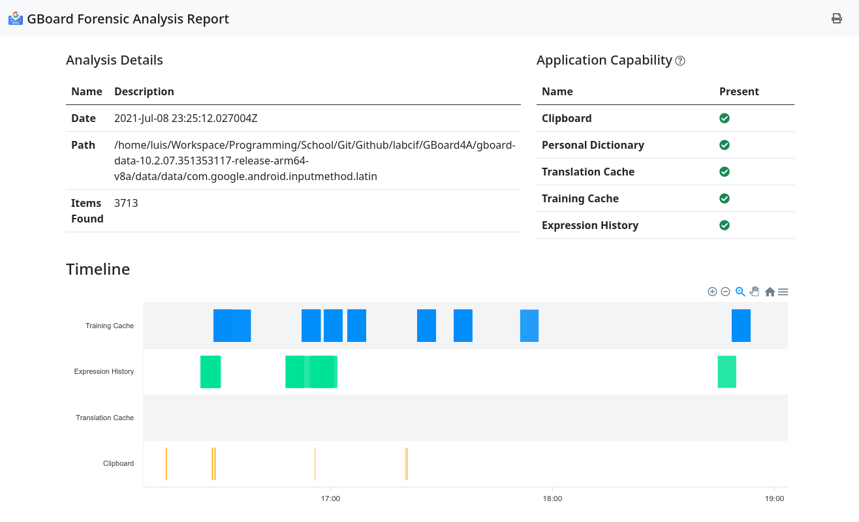
escola superior de tecnologia e gestão
GBoard Forensic Analyzer with Autopsy GBoard4A
What is Google Keyboard ?
Google Keyboard (GBoard) is the most popular virtual keyboard application developed by Google targeting mobile devices. The main features are:
Clipboard management
Smart suggestions
Multilingual support
Personal Dictionary
Expressions suggestions
Main goals of this project:
Analyze and explore GBoard components and functionalities on an Android system
Identify the artifacts created by using GBoard on an Android system
Development and integration of various technologies to facilitate investigation of forensic cases
Application structure:
Ingest Data Source Module: Autopsy module that integrates the extracted content gathered from the standalone application.
General Report Module:
Autopsy module that easily generates a HTML5 compatible and portable report file
Authors: João Lourenço, Luís Ferreira
Mentors: Miguel Negrão, Miguel Frade, Patrício Domingues

